Slide 1
AI Agent for Digital Financial Literacy
IBM AICTE PROJECT
Presented By:
Student name : GADHIRAJU JAYENDRA VARMA
College Name & Department : ANITS & CSE

Slide 2
OUTLINE
Problem Statement
Technology used
Wow factor
End users
Result
Conclusion
Git-hub Link
Future scope
IBM Certifications

Slide 3
Problem Statement
The Challenge – An AI Agent for Digital Financial Literacy, powered by RAG (Retrieval-Augmented Generation), helps users understand and navigate essential financial tools and practices. It retrieves reliable content on using UPI, avoiding online scams, understanding interest rates, budgeting, and personal finance management from government portals, banking websites, and educational platforms. With multilingual support, users from diverse backgrounds can interact in their preferred language and ask questions like “How do I send money via UPI?” or “What is a safe interest rate for a loan?” The agent ensures financial literacy is accessible, personalized, and culturally inclusive. This AI-driven assistant empowers users with knowledge, protects them from fraud, and builds confidence in digital finance.

Slide 4
Technology used
IBM cloud lite services
Natural Language Processing (NLP)
Retrieval Augmented Generation (RAG)
IBM Granite model

Slide 5
IBM cloud services used
IBM Cloud Watsonx AI Studio
IBM Cloud Watsonx AI runtime
IBM Cloud Agent Lab
IBM Granite foundation model

Slide 6
Wow factors
The AI Agent for Digital Financial Literacy brings together a unique combination of cutting-edge technologies and user-centric design to transform how people access financial knowledge. One of its standout features is multilingual support, allowing users to interact in Indian regional languages, making financial education accessible to all. Powered by Retrieval-Augmented Generation (RAG) and IBM Granite, it provides accurate, reliable responses drawn directly from trusted government and banking sources, eliminating misinformation. The agent delivers personalized guidance tailored to each user’s background—whether a student, elderly person, or daily wage earner—making complex topics like budgeting, interest rates, and UPI use simple and relatable.

Slide 7
End users
Elderly Citizens
Students & Young Adults
Daily Wage Workers
Self-Employed & Small Business Owners

Slide 8
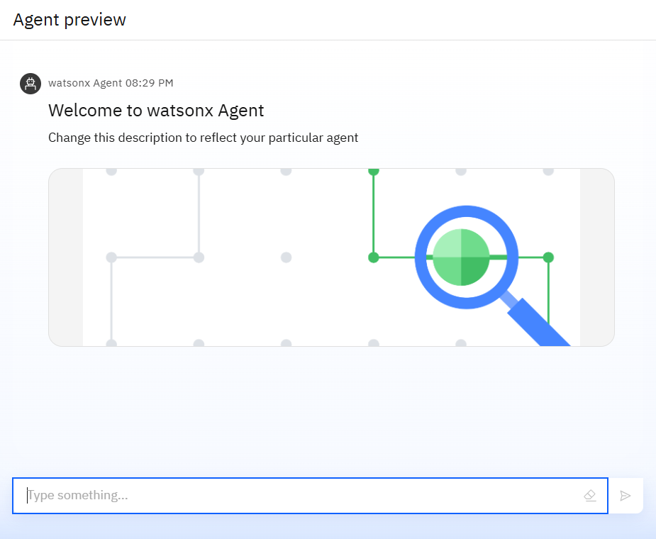
Results

Slide 9
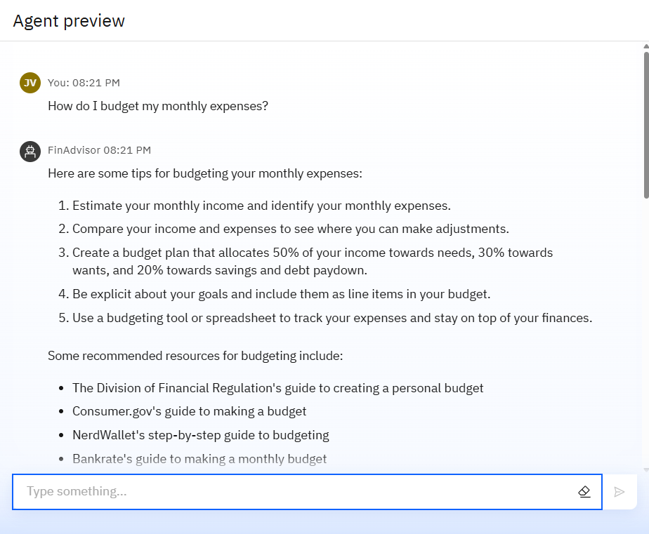
Results

Slide 10
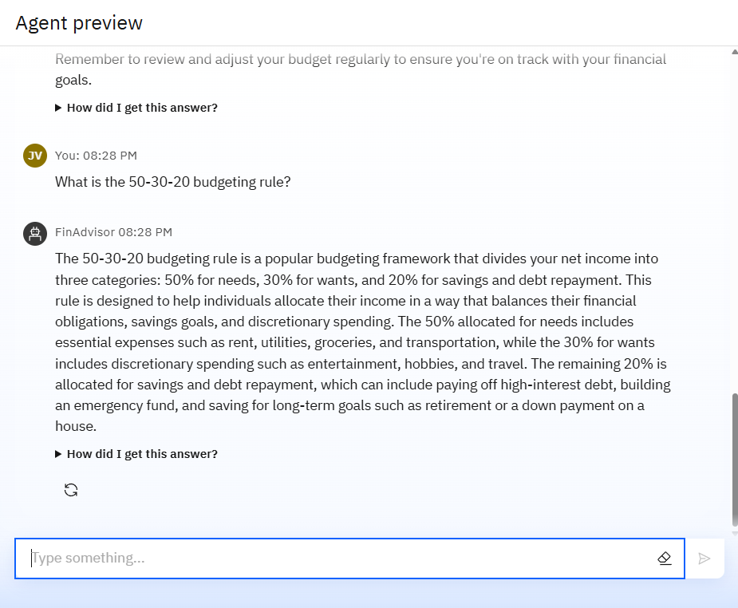
Results

Slide 11
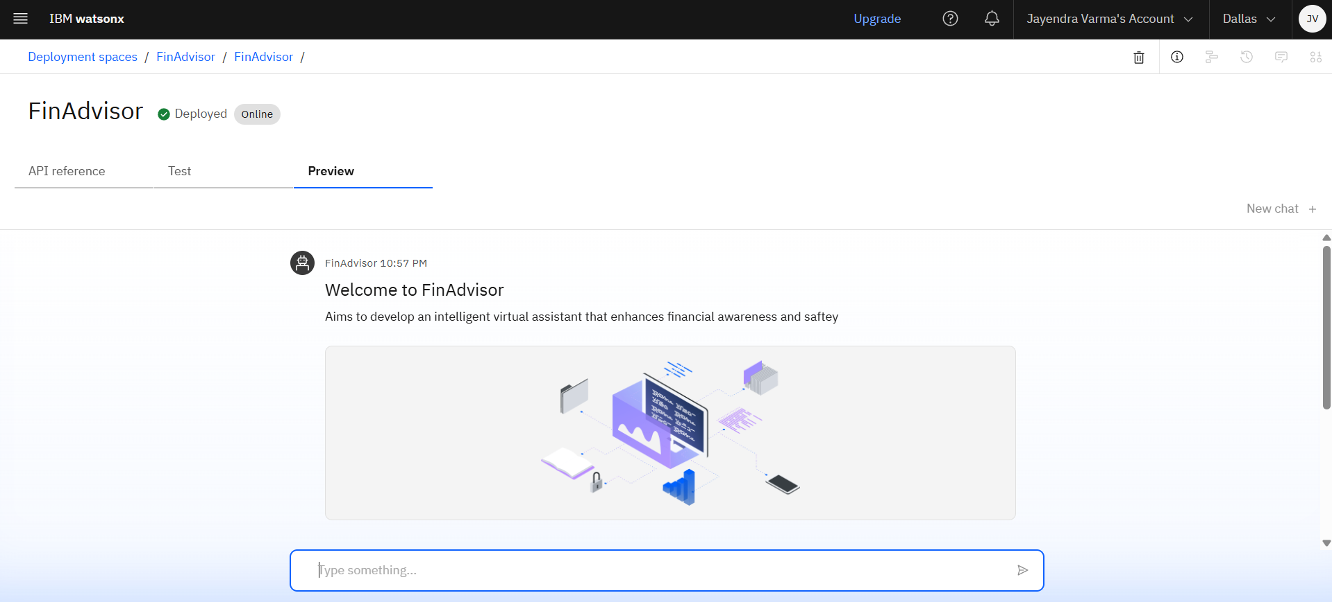
Results
Deployed AI Agent

Slide 12
Conclusion
The agent empowers users by simplifying complex financial concepts through personalized, language-friendly interactions.
It educates users on digital tools like UPI, interest rates, and budgeting, enabling informed financial decisions.
Ultimately, the agent builds confidence and independence in digital finance, supporting India’s vision of a digitally empowered society.

Slide 13
GitHub Link
https://github.com/gjvarma45/Finance_Literacy.git

Slide 14
Future scope
Multilingual Expansion Across Indian & Global Languages
Voice-Activated Financial Assistant
Personalized Financial Goal Setting & Tracking
Integration with Digital Banking Platforms
Financial Wellness Dashboard
Offline & Low-Bandwidth Functionality

Slide 15
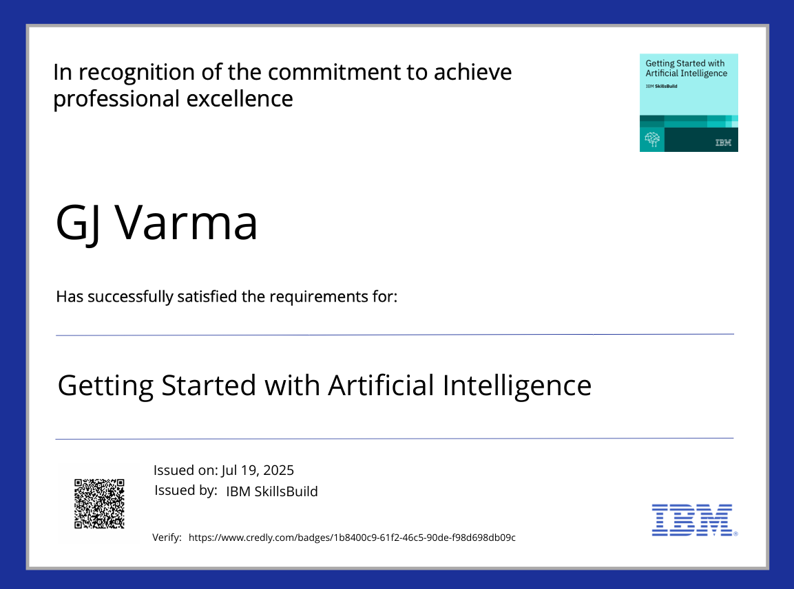
IBM Certifications

Slide 16
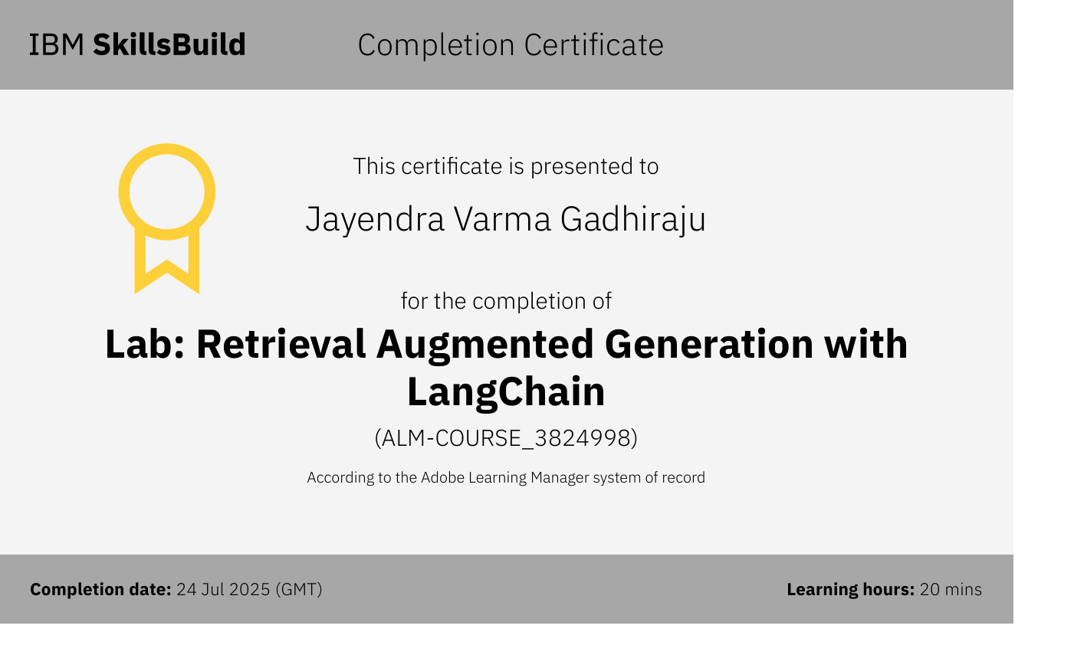

Slide 17
THANK YOU

